Slide 1
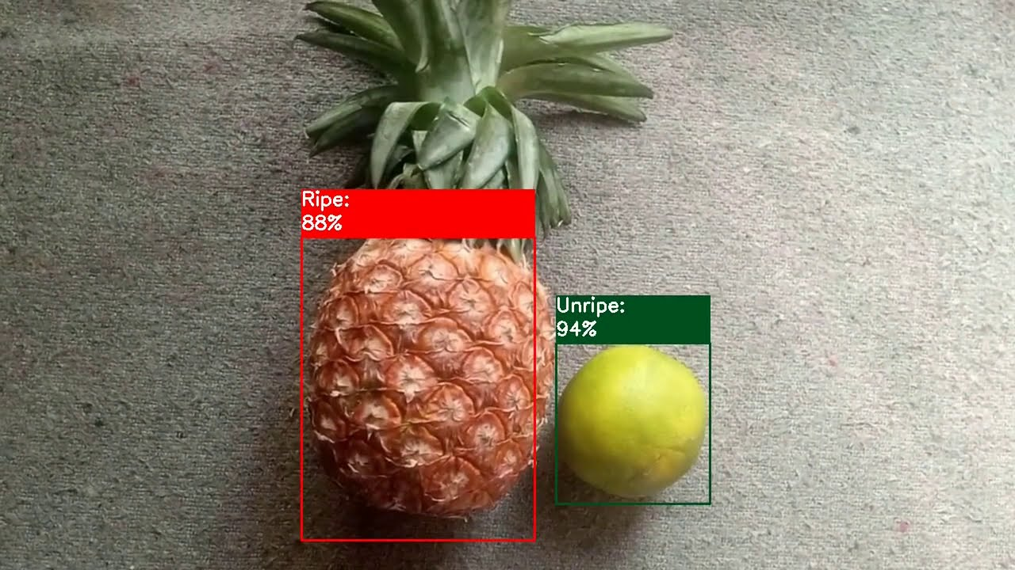
Object Detection Selected-2
Presentation Topics
Architecture Used in Paper
Dataset Details
Implementation Details
Results and Visualization
Under the supervision of Dr Wesam El-behaidy
Helwan University
MEMBER 1 | MEMBER 2 | MEMBER 3 | MEMBER 4 | MEMBER 5 (TL) | MEMBER 6
20180002 | 20180003 | 20180004 | 20180140 | 20180173 | 20180442
ابانوب رافت وديع | ابانوب كمال عطيه | ابانوب مجدي اسعد | اندرو عماد كامل | جرجس حنا سمعان | كيرلس هاني مكرم

Slide 2

Presentation Topics
Architecture Used in Paper
Dataset Details
Implementation Details
Results and Visualization

Slide 3

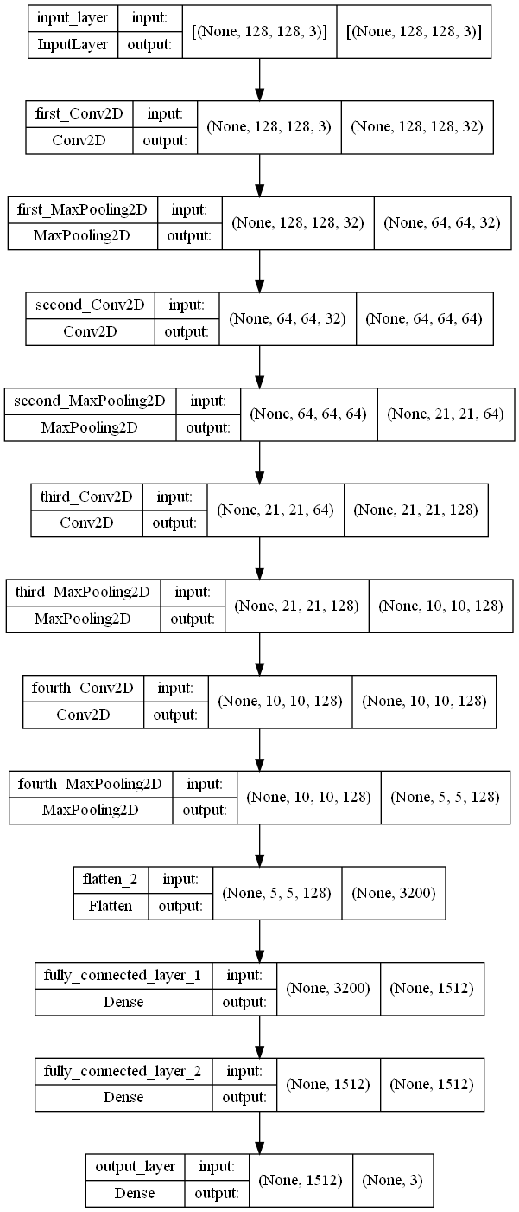
Architecture Used
Paper Details
This paper proposed CNN network architecture consists of multiple conventional layers (CONV), subsampling layer (polling layer), and fully connected layers. The proposed CNN model takes image is an input with (128, 128, 3) size. The proposed network consists of four Blocks; each block contains convolutional and pooling layers. In the first block, the convolutional layer having 32 filters with (3, 3) size and the same padding, while the Maxpooling size is (2, 2). The second block contains one convolution layer having 64 filters of size (3, 3) and the same padding, while the Maxpooling size is the same. The third and Fourth blocks contain one convolution layer having 128 filters of size (3, 3) with the same padding and max pooling size (2, 2). The two fully connected layers (FC) using ReLU activation function. In contrast, the output layer has (1,7) classed and SoftMax activation functions .

Slide 4
Dataset details
Before Augmentation
Only fruits were used from Fruits and Vegetables Image Recognition Dataset.
Some augmentation algorithms were applied to each image. The dataset contains 7 classes, each class has a different number of sample.
After Augmentation
Each sample has different width and height from the rest. This issue is solved in the preprocessing phase to be 128 pixels for width, 128 pixels for height and three channels for color (RGB).
The augmentation process is taking care of the different number of samples per class by applying various functions, such as horizontal and vertical flip, blurring, Gaussian noise, and some random rotation and crops. These functions enabled us to produce 300 samples per class led to the creation of 2100 images.
Class label | Number of samples
Apple | 26
Banana | 29
Grapes | 46
Kiwi | 18
Pear | 42
Pineapple | 32
Watermelon | 17
 | Total: 210
Class label | Number of samples
Apple | 300
Banana | 300
Grapes | 300
Kiwi | 300
Pear | 300
Pineapple | 300
Watermelon | 300
 | Total: 2100

Slide 5
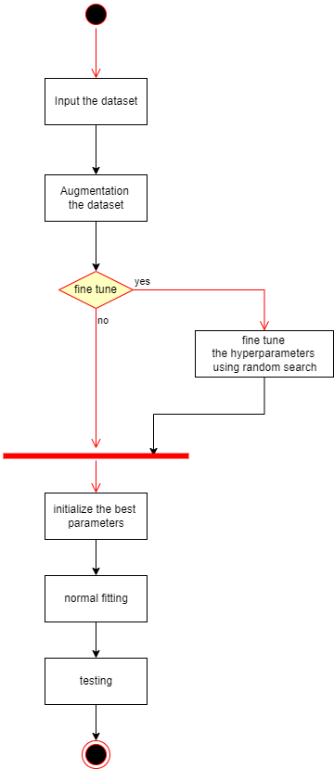
Implementation Details
Workflow
The dataset has been divided into 60% training (1260 samples), 20% testing (420 samples) and 20% validation (420 samples). Stratify by the target labels with a random state equal to 42
The next block diagram shows all phases of the project from reading the dataset to testing:
Hyperparameters
We used all hyperparameters that have been used in the paper and applied some fine tuning to them to find the best parameters that reach the highest accuracies. The model has been trained on 10 epochs to find these parameters. This does not mean we reached the best accuracy we could for this model. Training, validation and testing data have the same percentage each time the model has been trained. The input shape is (128, 128, 3) and the output length is equal to 7 as well. Accuracies measured using cross-validation accuracy which is three iterations.
The next table is a description of some of the hyperparameters.
Hyperparameter | Description
n_hidden | Number of flattened hidden layers
neurons | Number of neurons in the single flatted hidden layer
Add_dropout | Adding a dropout layer after each hidden layer
Add_batch_normalization | Adding batch normalization after each hidden layer
N_hidden | N_neurons | Activation function | Batch normalization | Dropout | Optimizer | Learning rate | Accuracy train | Accuracy validation
1 | 64 | Tanh | False | True | SGD | 0.0003 | 0.936111111 | 0.858730159
1 | 64 | Elu | True | True | SGD | 0.0001 | 0.987301587 | 0.861904762
2 | 32 | Relu | False | False | SGD | 0.0001 | 0.996031746 | 0.861904762
2 | 32 | Tanh | True | False | SGD | 0.0003 | 1 | 0.900793651
2 | 64 | Relu | False | True | Adam | 0.0003 | 0.93452381 | 0.906349206
2 | 32 | Elu | False | True | SGD | 0.0003 | 0.999206349 | 0.922222222
2 | 64 | Elu | False | False | Adam | 0.0001 | 1 | 0.926190476
2 | 32 | Elu | True | False | Adam | 0.0001 | 0.997222222 | 0.935714286
2 | 64 | Elu | True | True | Adamax | 0.0003 | 1 | 0.949206349
2 | 64 | Elu | True | False | Adam | 0.0001 | 1 | 0.962698413
1 | 32 | Relu | True | False | Adam | 0.001 | 1 | 0.9714
We adjusted some hyperparameters to reach the best accuracies

Slide 6
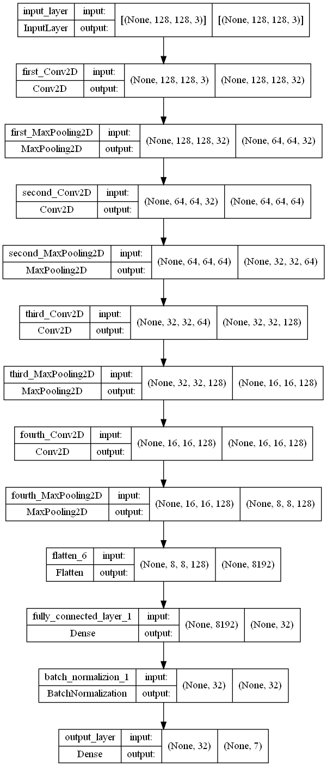
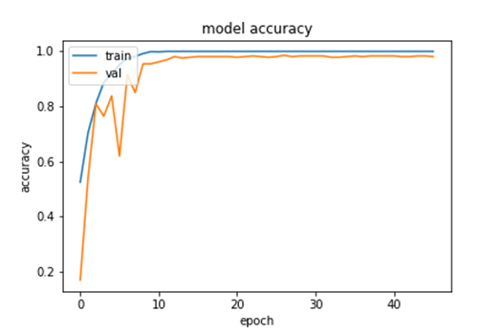
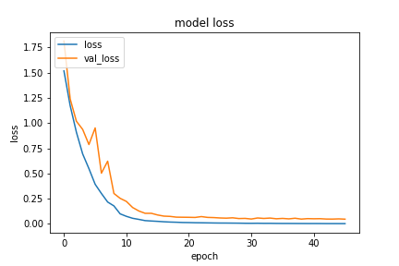
Results and Visualization
Results
After finding the best parameters, We trained the model with these hyperparameters on 48 epochs to reach the accuracies that is demonstrated in the next table.
Visualization
The next two figures show the learning curve and explain that the model doesn’t suffer from overfitting due to the equality of the validation accuracy and loss with the train accuracy, and it doesn’t suffer from underfitting due to high values of the validation accuracy and train accuracy.
N_hidden | 1
N_neurons | 32
Activation function | Relu
Batch normalization | True
Dropout | False
Optimizer | Adam
Learning rate | 0.001
Epochs | 48
Train accuracy | 100%
Validation accuracy | 98.095%
Test accuracy | 99.2857%
Best model architecture

